Slide 1

AUGMENTED REALITY
By:
Kavya Reddy.V
12R11A05E5

Slide 2
Augmented reality is the integration of digital information with
the user's environment in real time.
Augmented reality (AR) is an indirect view of a
physical, real-world environment whose elements are augmented
by computer-generated sensory input such as sound,video,
graphics or GPS data.

Slide 3
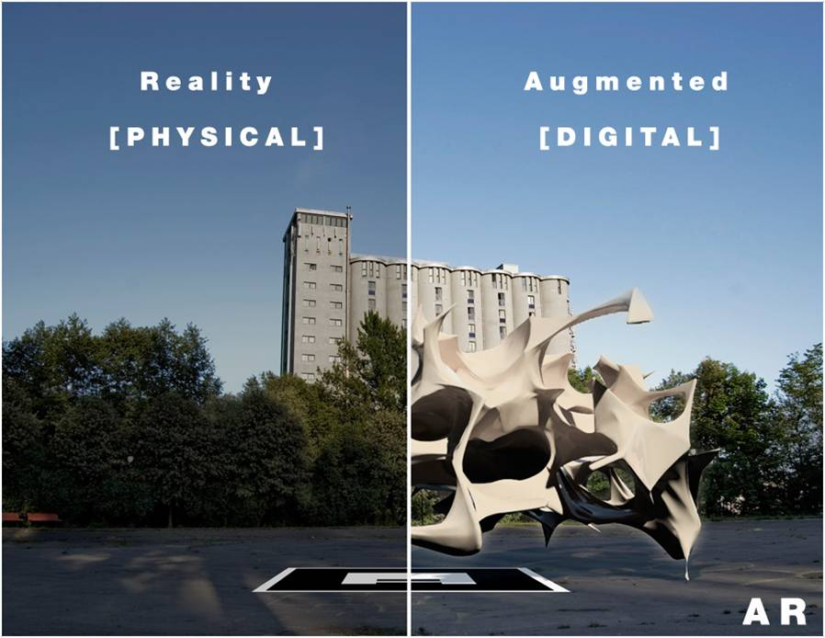
It is a combination of real
scene viewed by the user
and a virtual scene
generated by the computer
that augments the scene
with additional information

Slide 4
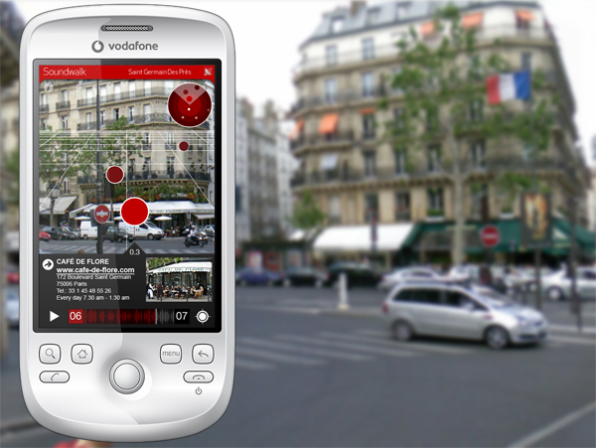
Augmented Reality in Cell Phones
primitive versions of augmented reality are already here on some cell phones, particularly in applications for the
iPhone and phones with the Android operating system.
LAYAR
uses the phone's camera and GPS capabilities to
gather information
can even point the phone at a building, and Layar will tell
you if any companies in that building are hiring, or it might
be able to find photos of the building on Flickr or to
locate its history on Wikipedia.

Slide 5
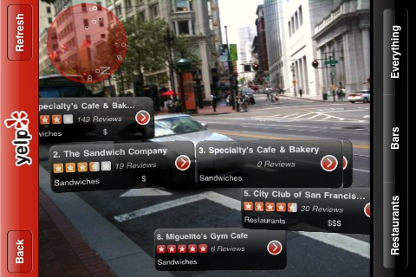
YELP Application
hidden augmented-reality component,
Monocle
Using your phone's GPS and compass,
Monocle will display information about
local restaurants, including ratings and
reviews, on your cell phone screen.

Slide 6
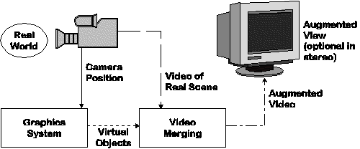
Working of Augmented Reality

Slide 7
TECHNOLOGY
HARDWARE:
Hardware components for augmented reality are: processor, display,
sensors and input devices.
Modern mobile computing devices like smartphones and
tablet computers contain these elements which often include
a camera and sensors such as accelerometer, GPS, and
solid state compass, making them suitable AR platforms

Slide 8
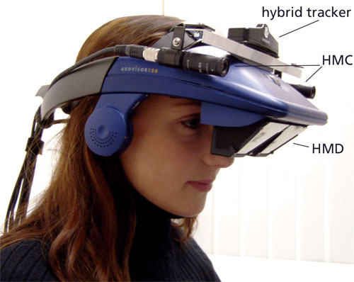
DISPLAY
Head-Mounted Display:
A head-mounted display (HMD) is a display device paired to a headset such as
a harness or helmet.
HMDs place images of both the physical world and virtual objects over the user's
field of view.

Slide 9
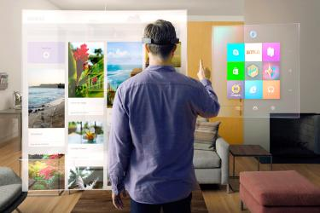
2. Eyeglasses
eyewear that employ cameras to intercept the real world view and re-display its augmented view through the
eye pieces.Some of the eyeglasses are:
Microsoft Hololens:
The true augmented reality concept that will, ideally, have wearers waving their arms around to interact with
Screens and full-colour virtual objects wherever they are.

Slide 10
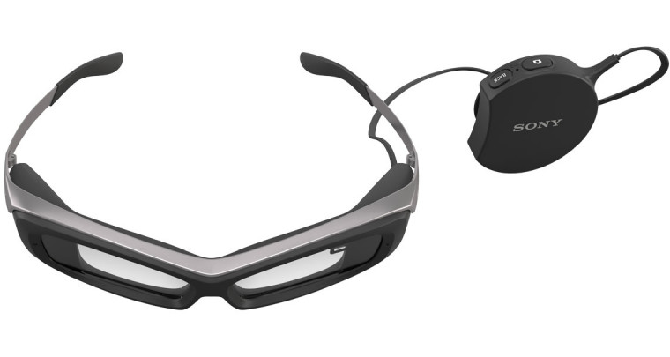
ii) Sony SmartEyeGlass:
Sony's SmartEyeglass wearable comes with thick rims, and serves as a heads-up display for your Android device.
You get information such as directions, Tweets related to your location and real-time voice translations via green
text that appears over the lenses.
This device also comes with a wire that connects down to the Smart Eyeglass' control pack, which is where
you'll find its touch controls, battery, microphone and speaker.

Slide 11
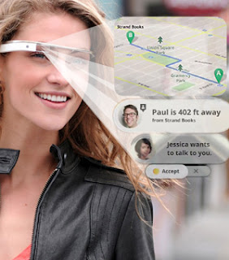
iii) Google Glass:
-With this tiny head-mounted display, you can see a number of superimposed information screens over your daily
life:
the weather, current events, missed calls, even turn-based navigation based on your smartphone's GPS.
- you can even tell the headset to take pictures of what you were looking at.

Slide 12
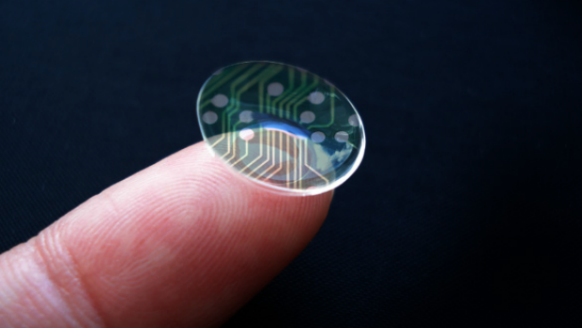
Contact lenses
These bionic contact lenses might contain the elements for display embedded into the lens including
integrated circuitry, LEDs and an antenna for wireless communication.
Contact lenses that display AR imaging are in development.

Slide 13
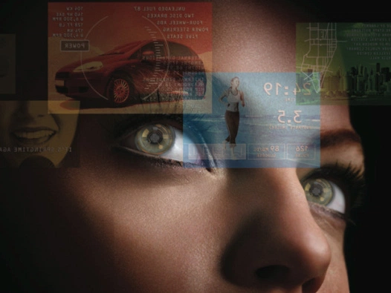
Virtual Retinal Display
With this technology, a display is scanned directly onto the retina of a viewer's eye.
The viewer sees what appears to be a conventional display floating in space in front of them.
-under development

Slide 14
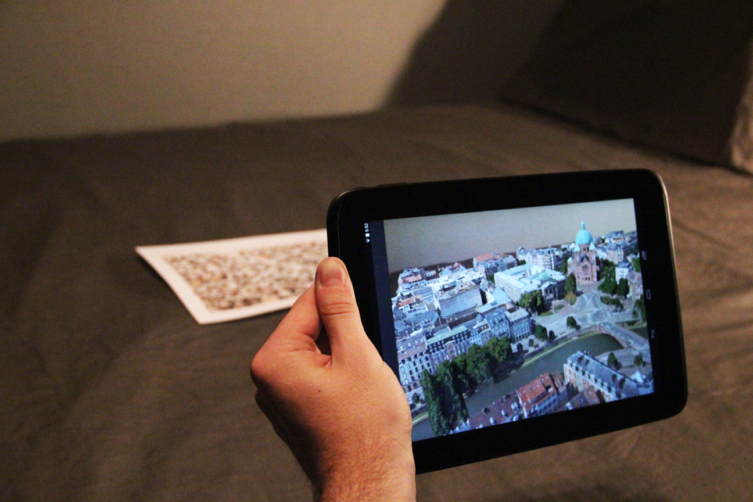
Handheld
A small display that fits in user’s hand
Portable
Ubiquitous nature of camera phones
User having to hold the device
Distorting effect compared to real world objects

Slide 15
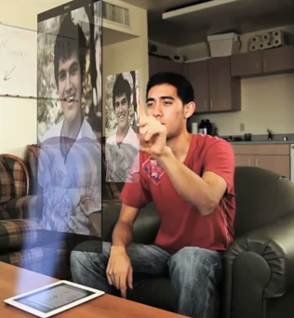
Spatial
Makes use of digital projectors to display graphical information
User is not required to carry the equipment or wear any device
Key difference is that-display separated from user so multiple users can use at the same time

Slide 16
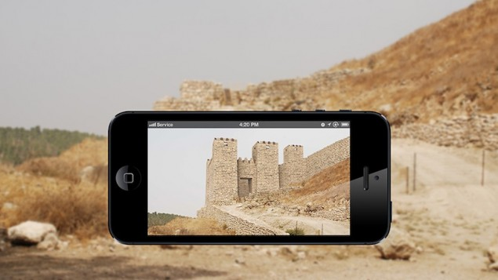
APPLICATIONS OF AUGMENTED REALITY
1. Archaeology

Slide 17
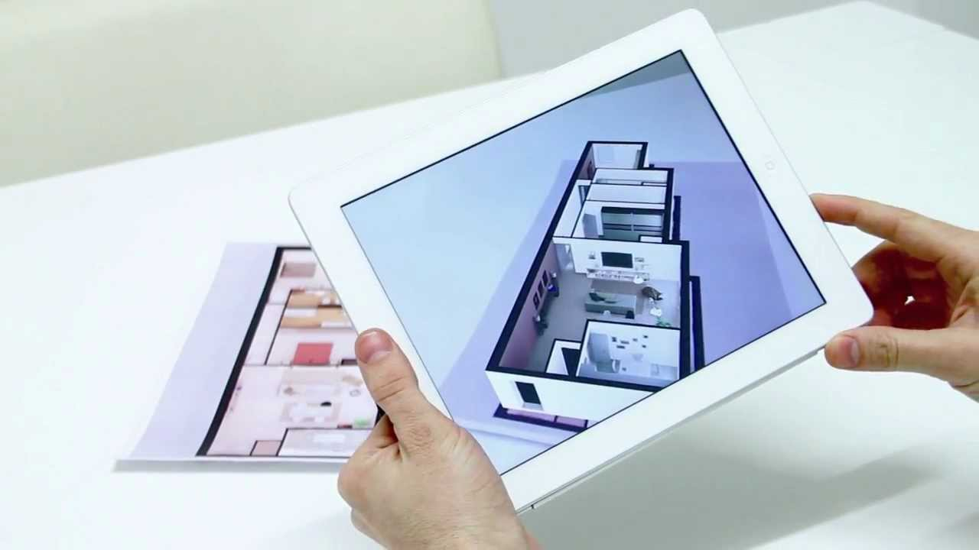
2. Architecture

Slide 18
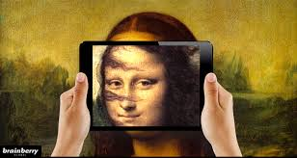
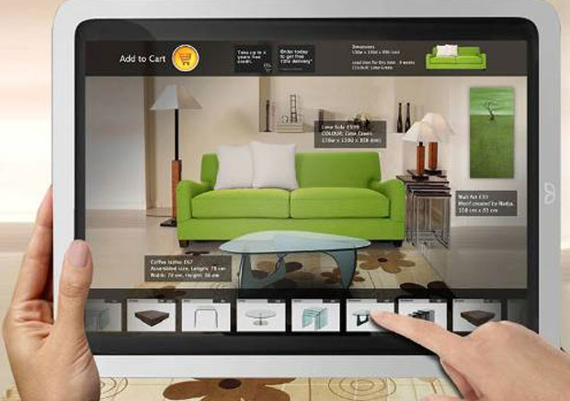
3. Art
4. Commerce

Slide 19
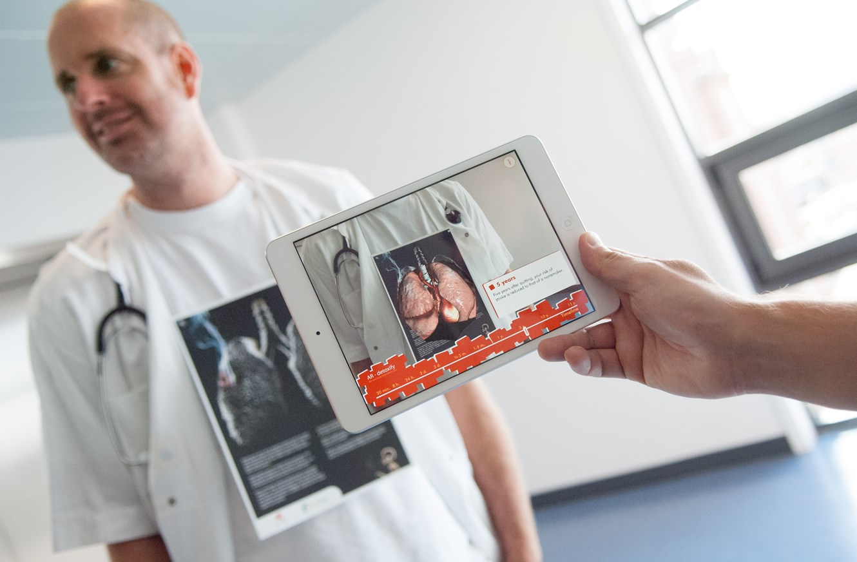
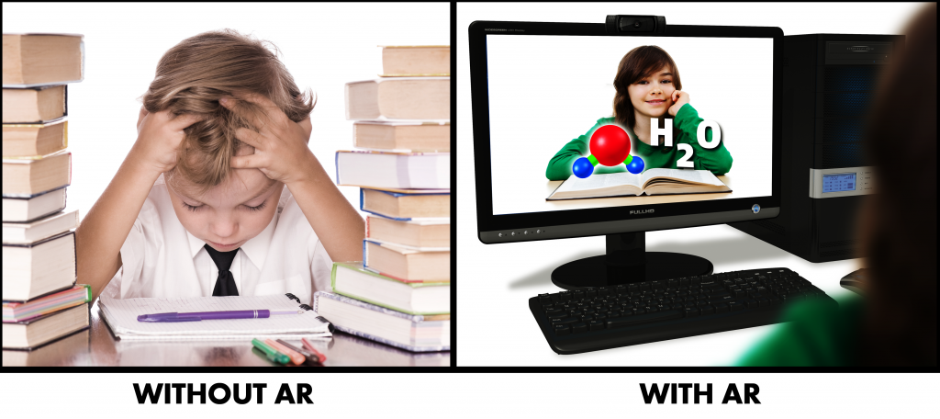
5. Education

Slide 20
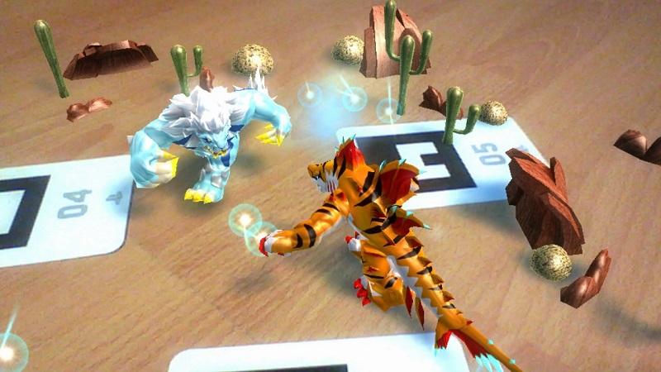
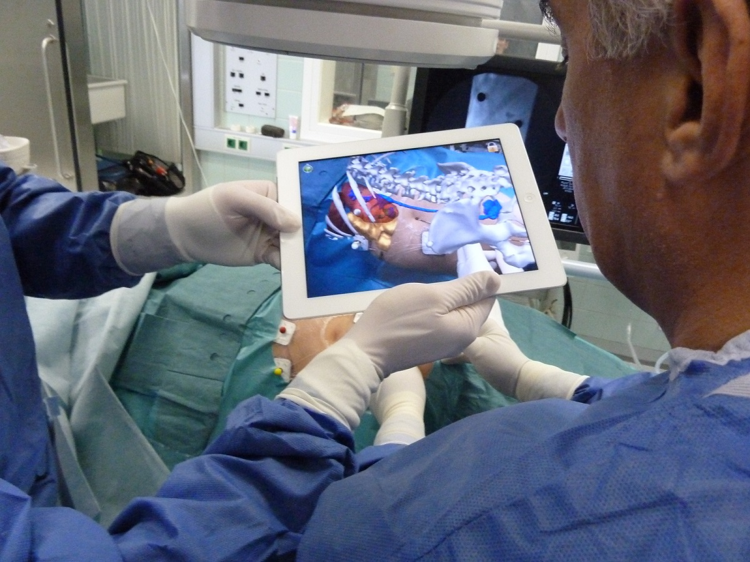
6. Gaming
7. Medical

Slide 21
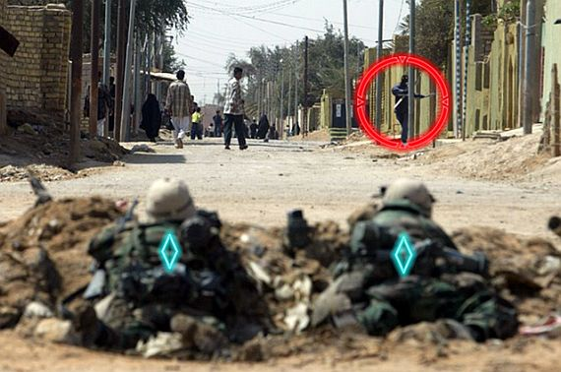
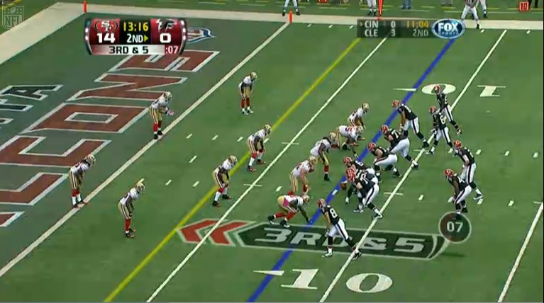
8.Military
9. Sports

Slide 22
LIMITATIONS:
GPS range
Cell phones having small screens
Privacy cconcerns

Slide 23
Thank You

